Slide 1
Digital Portfolio
STUDENT NAME: CHITHRA.P
REGISTER NO AND NMID: 21024U18009(NM ID (C66B9305F728EB092A444113DC79)
DEPARTMENT: BSC COMPUTER SCIENCE
COLLEGE: COLLEGE/ UNIVERSITY;SRI AKILANDESWARI WOMENS COLLEGE WADIWASH(THIRUVALLUVAR UNIVERSITY)

Slide 2
PROJECT TITLE
D
DIGITAL PORTFOLIO

Slide 3


AGENDA
Problem Statement
Project Overview
End Users
Tools and Technologies
Portfolio design and Layout
Features and Functionality
Results and Screenshots
Conclusion
Github Link
3/21/2024 Annual Review

Slide 4

PROBLEM STATEMENT
online presence to In today’s digital era, professionals need an
showcase their skills, projects, and achievements. A simple résumé is often not enough to demonstrate practical knowledge. The problem is the lack of a centralized, accessible, and interactive platform for presenting professional capabilities.

Slide 5

This project is a personal digital portfolio website created using HTML, CSS, and basic JavaScript. It provides an organized space to highlight: About Me (professional summary) Skills Projects Contact information The portfolio is responsive, user-friendly, and visually appealin
PROJECT OVERVIEW

Slide 6
Employers / Recruiters – to evaluate skills and projects. Peers / Colleagues – for collaboration opportunities. Students / Learners – to take inspiration for building their own portfolios. General Audience – to connect, learn, or reach out.
WHO ARE THE END USERS

Slide 7

HTML5 → for structure and content. CSS3 → for styling, layout, and responsiveness. JavaScript (basic) → for interactivity (e.g., contact form handling). VS Code / Any IDE → for development. Browser (Chrome/Edge/Firefox) → for testing and deployment.
TOOLS AND TECHNIQUES

Slide 8
Navigation Bar – links to About, Skills, Projects, and Contact sections.
About Section – professional summary with goals.
Skills Section – list of technical abilities.
Projects Section – showcase of completed projects with images and descriptions.
Contact Section – email, LinkedIn link, and contact form.
Footer – copyright and credits.
Design Style: Clean, simple, with soft background (#f4f4f4) and dark header/footer (#333) for contrast.
PRTFOLIO DESIGN AND LAYOUT

Slide 9
Responsive layout for desktop and mobile. Organized navigation with section-based scrolling. Image placeholders for projects. Contact form with success message. User-focused design with readability and accessibility
FEATURES AND FUNCTIONALITY

Slide 10
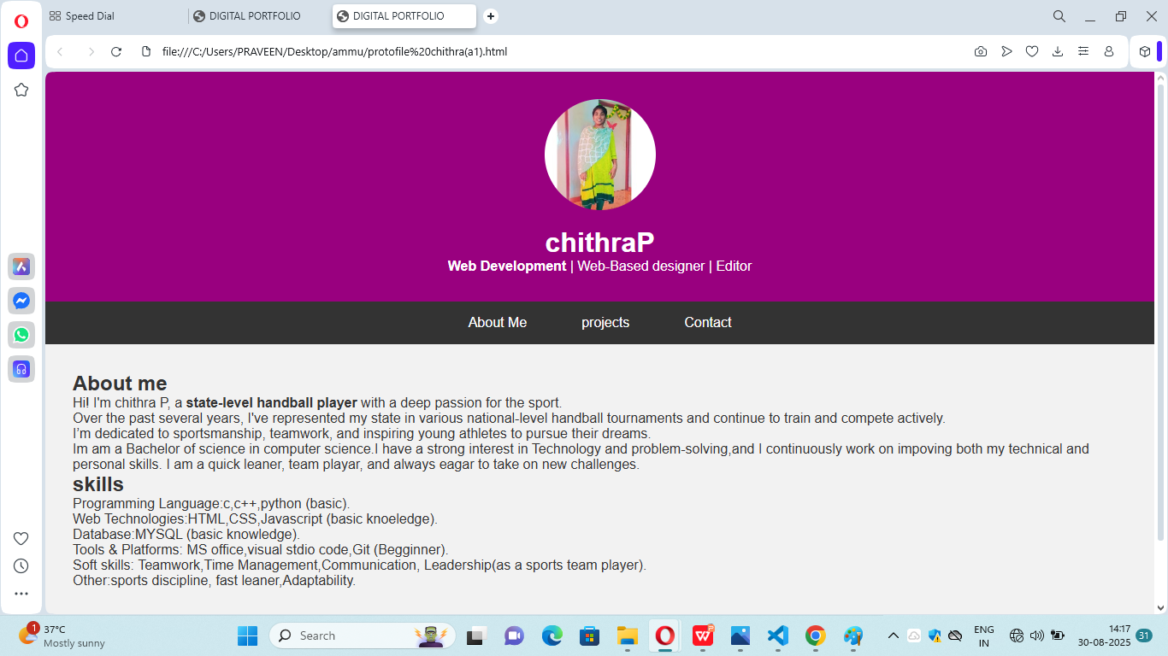

RESULTS AND SCREENSHOTS
3/21/2024 Annual Review

Slide 11
CONCLUSION
The digital portfolio successfully provides a professional
online presencefor IT professionals. It highlights skills,
achievements, and projects in a structured manner.
This project demonstrates the use of web development
fundamentals and serves as a foundation for future
enhancements like backend integration, hosting, or adding advanced interactivity.

Slide 12
GITHUB
https://github.com/chithuperumal/TNSDC-FWD-Digitalportfolio.git

